Slide 2
[Insert meaning here]

Slide 4
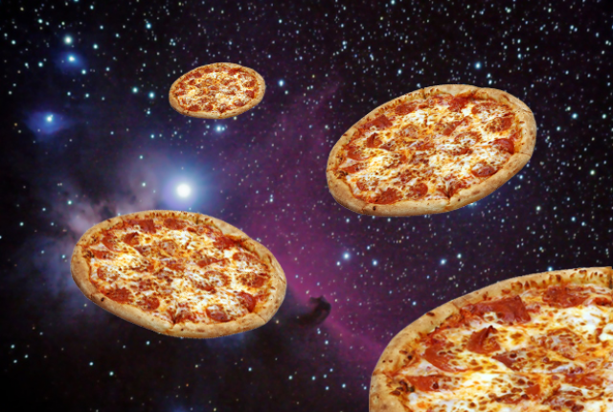

Slide 5
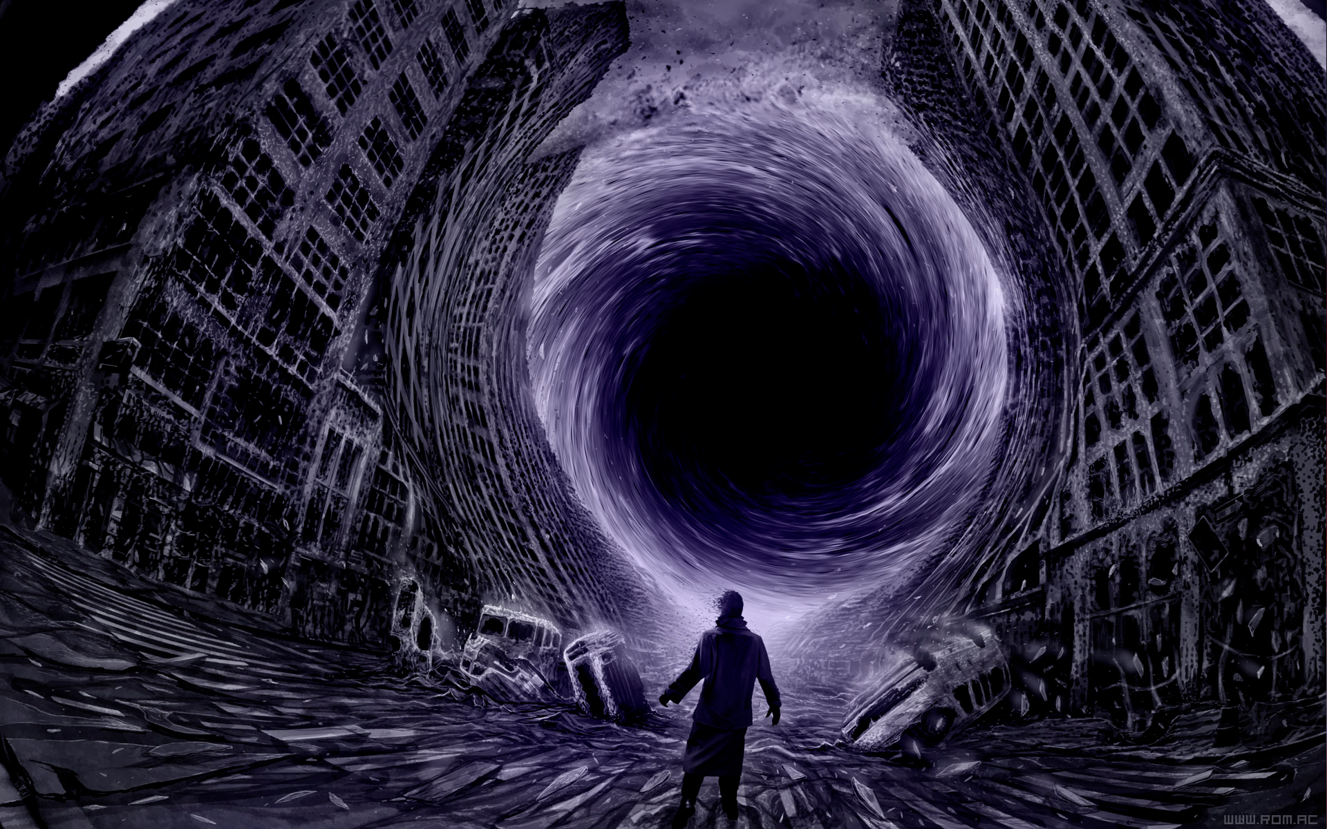

Slide 13
CITED PICS
https://www.google.com/url?sa=i&rct=j&q=&esrc=s&source=images&cd=&cad=rja&uact=8&ved=0ahUKEwjpnvXxkq7MAhUMsIMKHZ1hBHcQjRwIBw&url=http%3A%2F%2Fthesixpac.blogspot.com%2F2013%2F04%2Fstaring-into-void.html&bvm=bv.120551593,d.amc&psig=AFQjCNENzrFz0l_f11kEgrU3vE8bk80U6A&ust=1461817058954903
https://www.google.com/url?sa=i&rct=j&q=&esrc=s&source=images&cd=&cad=rja&uact=8&ved=0ahUKEwjvs7K9k67MAhWDs4MKHUiBDDEQjRwIBw&url=http%3A%2F%2Fthesoulfulceo.com%2Fportfolio%2Ftrust-the-universe%2F&bvm=bv.120551593,d.amc&psig=AFQjCNEJDD7qm2IMnrWq9iF3k19FV4bhTg&ust=1461823592555804
https://i.gr-assets.com/images/S/photo.goodreads.com/hostedimages/1383354746i/6518659._SX540_.png
http://static4.businessinsider.com/image/518be06d69bedd5d2b000000/popular-hyperbole-and-a-half-web-comic-allie-brosh-returns-with-stunningly-brilliant-blog-post.jpg
https://i.ytimg.com/vi/3MyjGb_-lM8/maxresdefault.jpg
https://www.google.com/url?sa=i&rct=j&q=&esrc=s&source=images&cd=&cad=rja&uact=8&ved=0ahUKEwjQ-u-Nh7PMAhVGvIMKHf6PCoIQjRwIBw&url=https%3A%2F%2Fthemotivationmentalist.wordpress.com%2F2014%2F03%2F17%2Fcompilation-of-the-best-of-socrates-wisdom-of-ages%2Fthe-unexamined-life-is-not-worth-living%2F&psig=AFQjCNHGr9fIAO_gOTX0rPi4otgJt4YeiQ&ust=1461992076483829
http://www.photographyblogger.net/wp-content/uploads/2009/12/Nothingness25.jpg
http://handsonatl.org/wp-content/uploads/2015/10/law_of_attraction_2point0.jpg

